Slide 1
Amazon AI User Reviews Aggregator
By Benjamin Hunt & Edwin Santiago

Slide 2
Why AI for user review aggregation?
How can we help businesses improve their products and services through the use of AI Sentiment Aggregation?
Why is it worth exploring?
Model 1 Model 2 Model 3
TF-IDF + Sentence Embeddings → Linear SVM → Transformer Sentiment
Unsupervised Supervised

Slide 3
Introducing
The Amazon User Review Aggregator!
Goal: Compare Human vs AI reviews to guide decisions.
How? See through user randomness and get straight to the point with our user review “sentiment” based AI aggregator by focusing the model on sentiment analysis.

Slide 4
Our Story (Methods)
Seeking ground: Studying data and deep preprocessing of Amazon user reviews.
Assessing (Negative/Neutral/Positive) Reviews.
Finding Ground: Starting with a simple TF-IDF sentiment baseline to set a quick benchmark and expose common failure cases, though un-supervised learning clustering sentiment data. → Model Macro F1: 0.36
Sharpening sentiment edges: Embedded reviews and clustered them to surface themes and compare how humans vs AI talk about products. → Model Macro F1:0.42
Exploring Deeper Generalization: Next we upgraded to a Linear SVM model for stronger classical NLP sentiment prediction and more stable generalization.
The land is ours!: Finally we fine-tuned key transformer model to capture context and nuance, giving our best end-to-end sentiment performance for deployment. → Model Accuracy: 0.91! Macro F1: 52

Slide 5
TF-IDF- K-Means & GMM classifier - “unsupervised”
Goal: Explore sentiment patterns without using labels (no star ratings needed).
Method: convert each review into a meaning vector (sentence embeddings), then cluster similar reviews together (e.g., GMM).
Why we did it: to see whether sentiment and themes naturally separate on their own, and to understand how the model “organizes” opinions.
What we found: Global clustering sentiment created too much noise in the data, The same when clustering based on product sentiment. F1 Macro is very low.

Slide 6
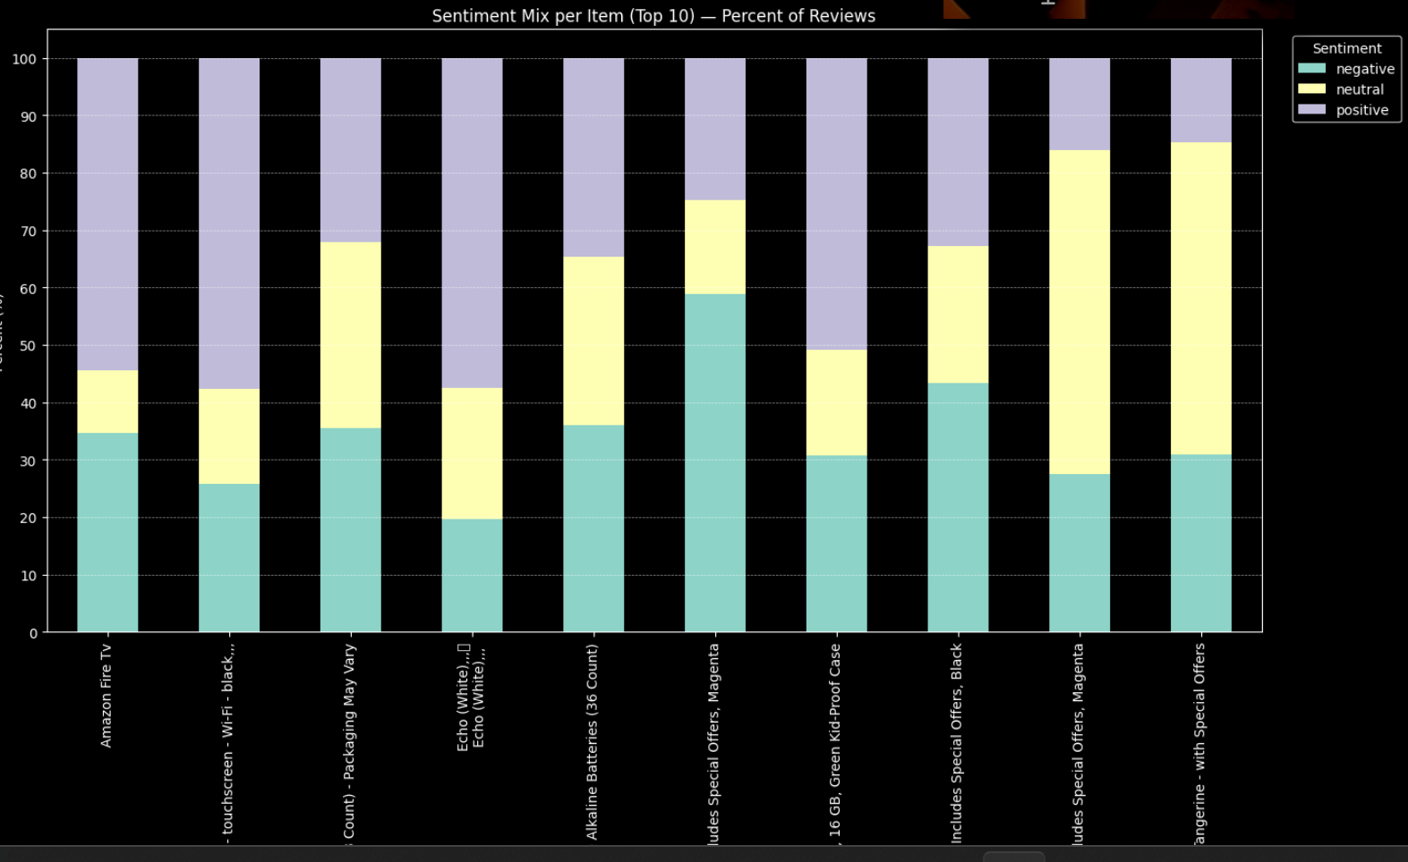
An unsupervised # Evaluation!

Slide 7
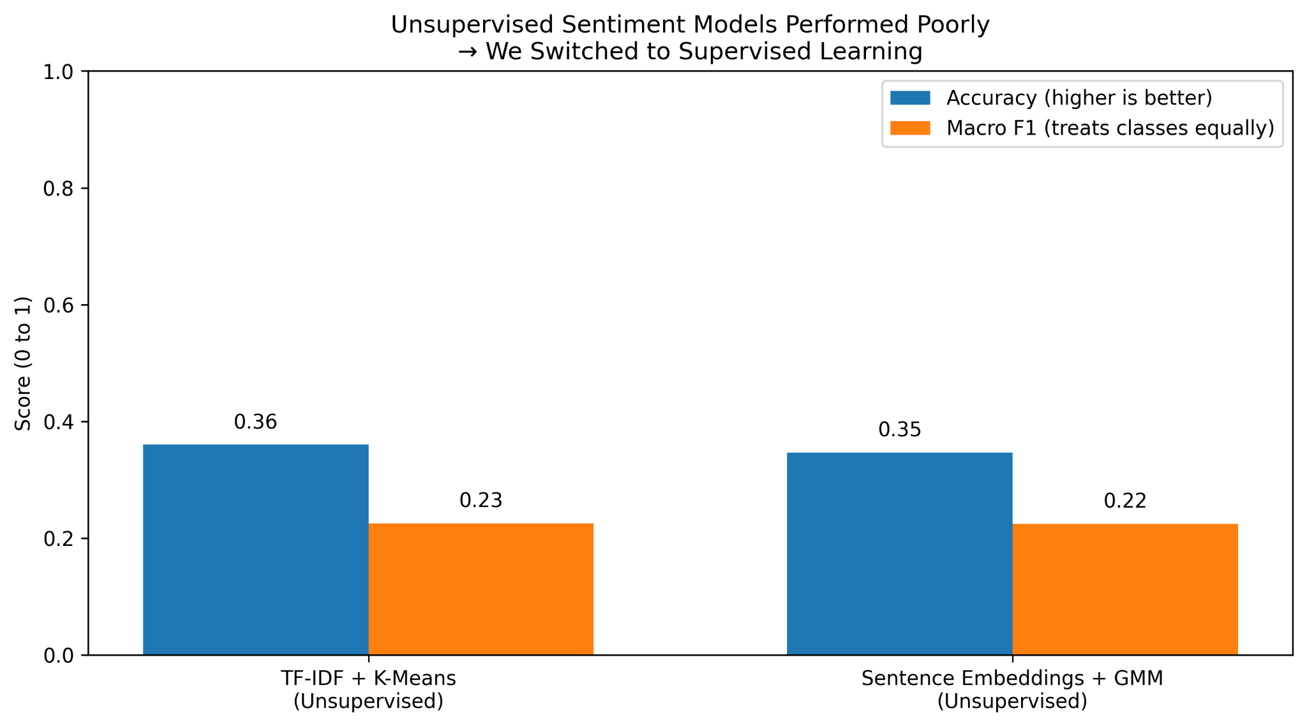
No More Unsupervised Clustering!

Slide 8
Model 2 - Product Meta Category Clustering
Problem: Product categories were sparse and highly fragmented, limiting interpretability.
Objective: Group products into 4-6 meaningful meta-categories.
Trained TF-IDF + class-weighted Linear SVM for sentiment classification.
Aggregated reviews per product to compute sentiment distribution and average rating.
Generated MiniLM embeddings and applied KMeans (k = 4) to form coherent meta-categories.

Slide 9
Model 2 Evaluation
Linear SVM achieved -95% accuracy (Weighted F1 = 0.95), showing strong sentiment classification performance.
Clustering showed moderate separation (Silhouette =0.16), indicating best separation among tested values.
Meta - categories were semantically coherent after manual inspection and UMAP/PCA visualization.
Controlled LLM summaries evaluated with ROUGUE low overlap due to paraphrasing rather than poor quality.

Slide 10
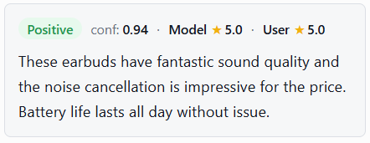
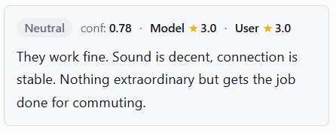
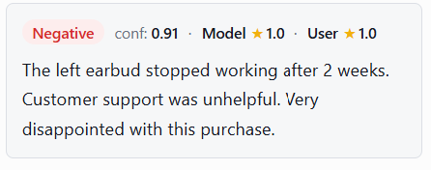
DeBERTa.v3 - “Supervised” Sentiment Analysis
Our Winning Model!
Used LoRA for fine tuning labeled data.
Excellent sentiment (sentence) focused handling for Neutral, Positive and Negative reviews! Macro F1 = 0.51 (Fairest overall sentiment handling)
Reads the whole sentence, not just each word.
Pointed in the right direction form labeled examples and avoids most sentiment mismatch noise!

Slide 11
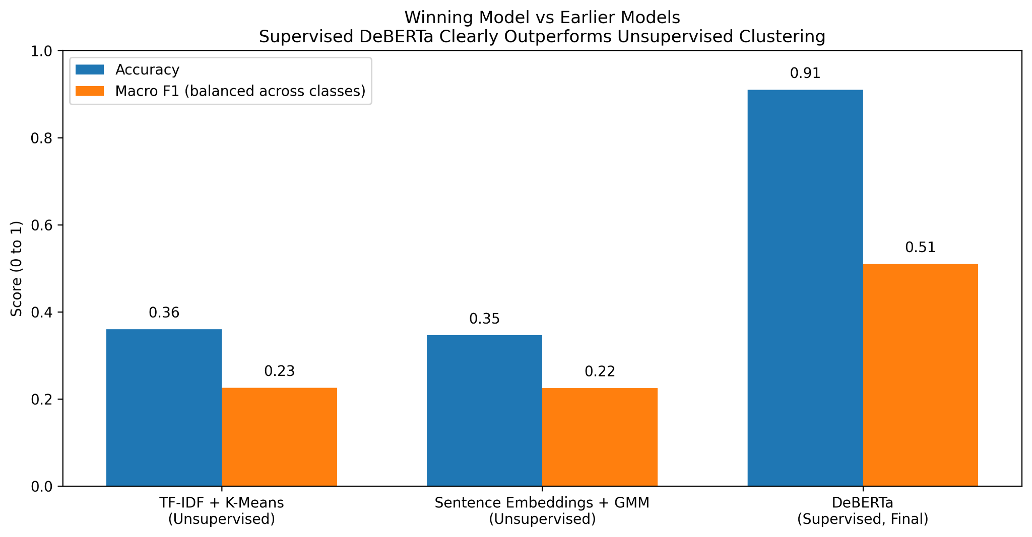
Sentiment Transformer Evaluation

Slide 12
Final Takeaways
Classical models don’t have the sentiment analysis capabilities like modern transformers.
Unsupervised clustering does not necessarily equal sentiment, even when applying more clustering.
AI is roughly 11-12 % stricter than humans on reviews based on human sentiment alone.
Macro F1 told the truth!
Sentiment models need supervised direction to appropriately understand sentiment handling.

Slide 13
DEMO
Website: https://amazon-user-review-aggregator-project.lovable.app

Slide 14
Questions?

